Slide 1
Chris Sainsbury
Consultant Physician (Diabetes & Endocrinology)
Gartnavel General Hospital
c.sainsbury@nhs.net
@csainsbury
http://glucose.ai
Notes:
1

Slide 2
What’s new in diabetes?
Type 1 diabetes
focus on glucose variability as metric
techniques to reduce variability: new insulins, CGMS / flash glucose monitoring, closed-loop sensor/pump systems
Type 2 diabetes
focus on glucose variability as key metric
move from surrogate to outcome driven therapeutic choices
Notes:
2

Slide 3
Type 1 Diabetes
Notes:
3

Slide 4
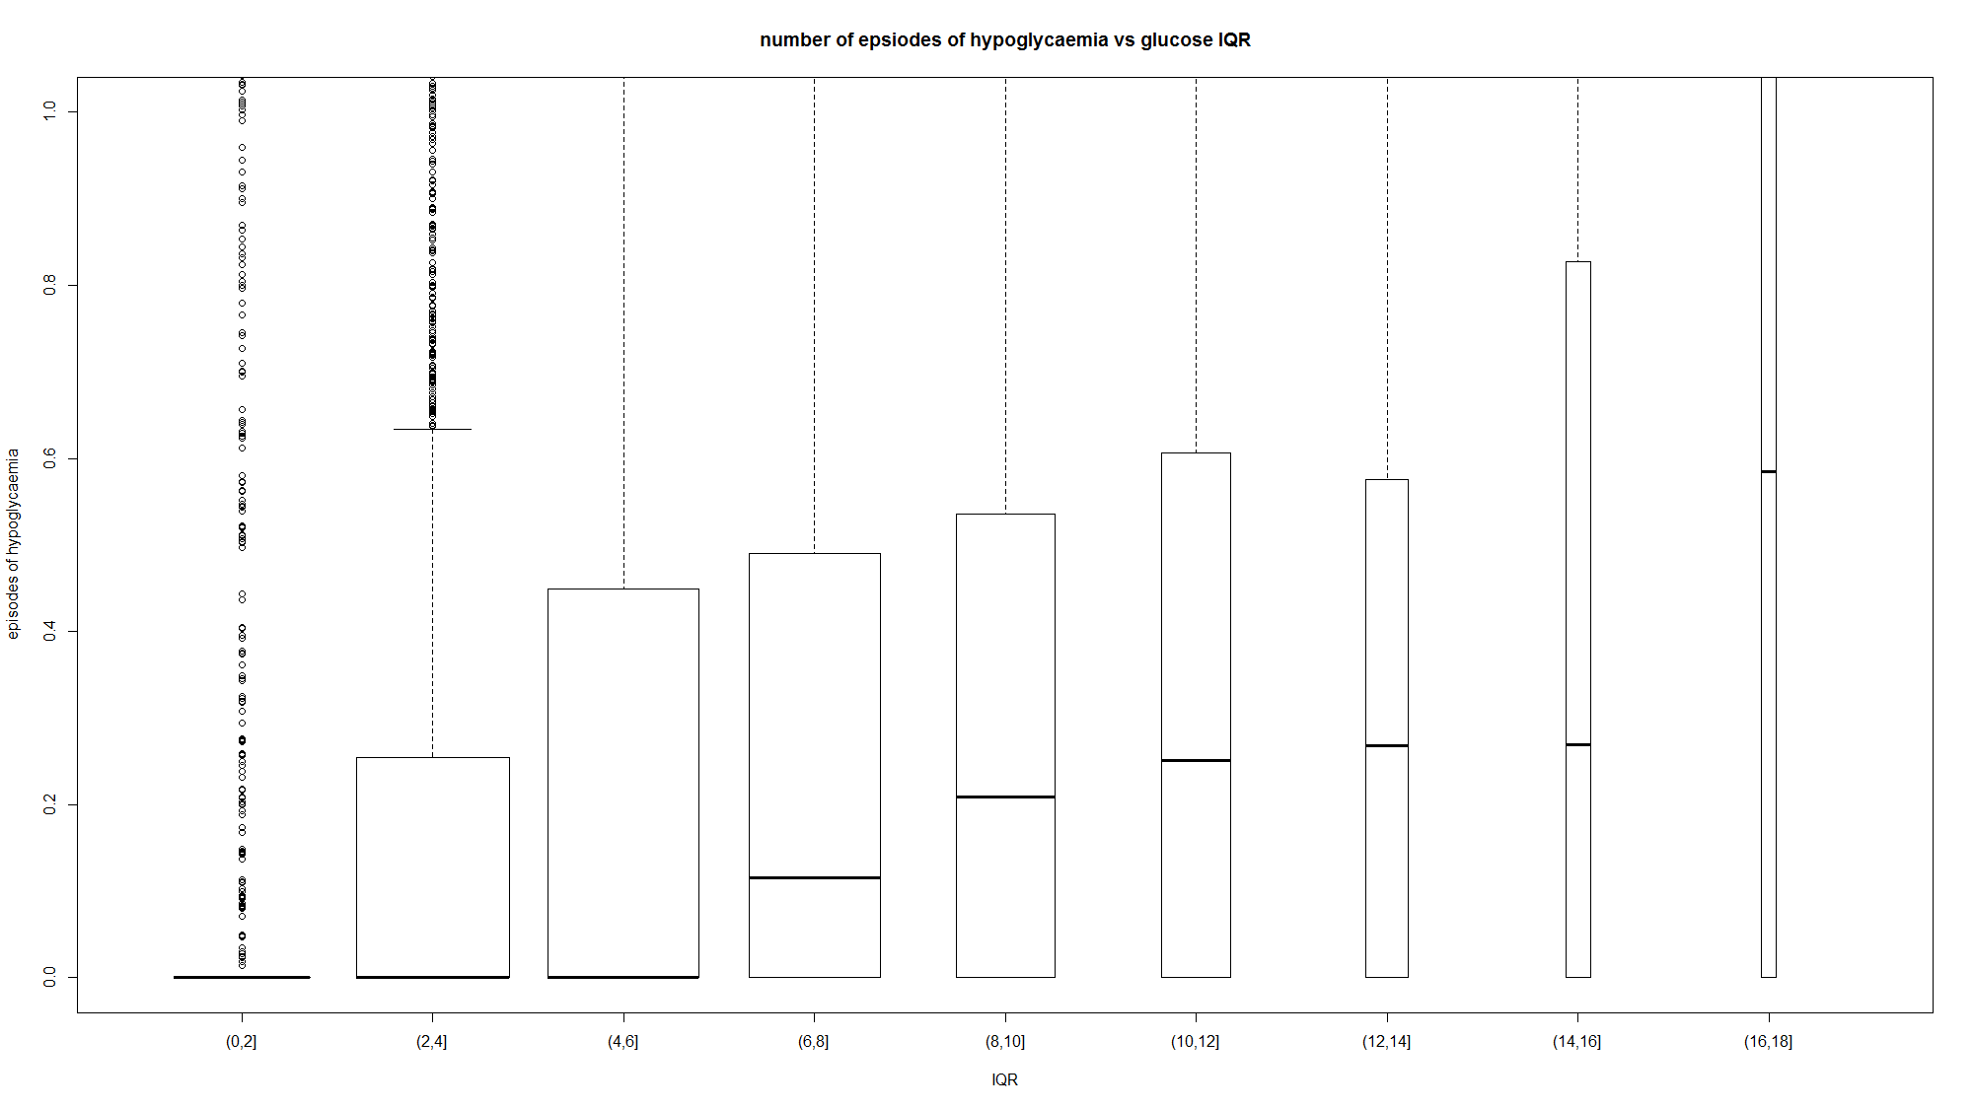
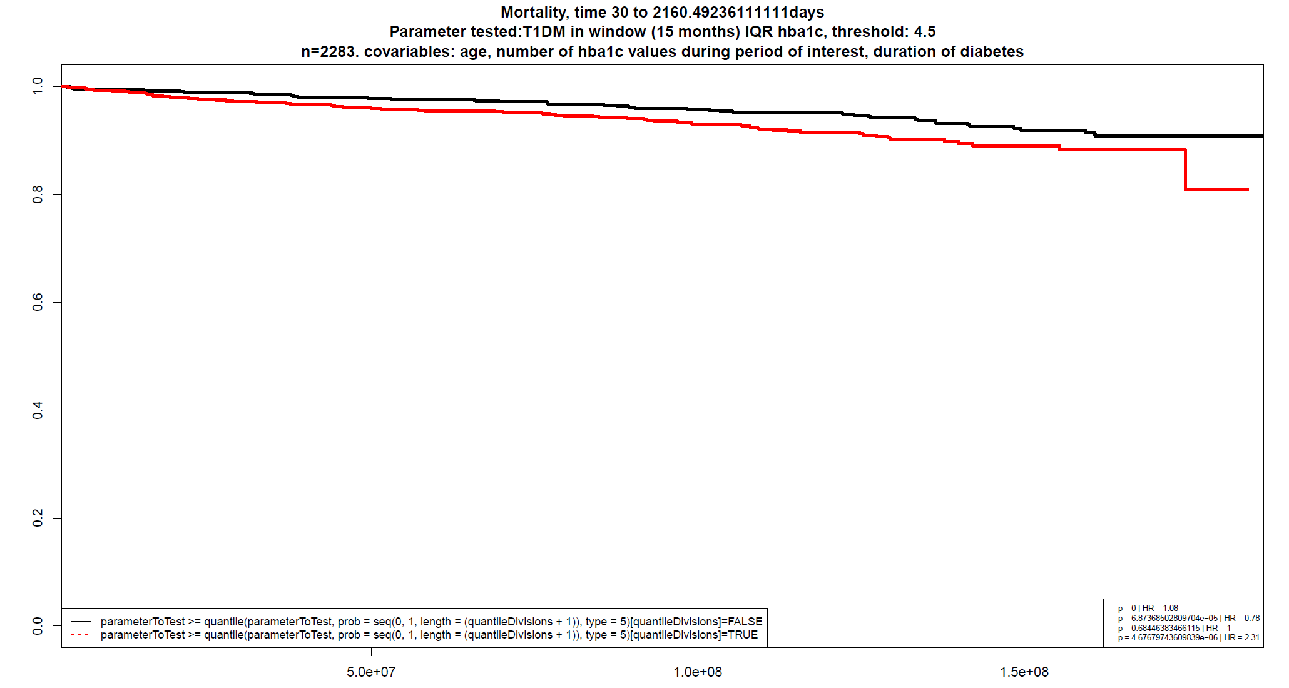
Type 1 diabetes: Glucose Variability
median glucose (HbA1c associated with complications) – has traditionally driven management decisions
multiscale glucose variability associates with short and long term outcomes (hypoglycaemia / mortality)
CBG variability vs inpatient hypoglycaemia rate
HbA1c variability vs 5y mortality (1)
1 Sainsbury et al, in press, Diabetic Medicine 2017
Notes:
4

Slide 5
Type 1 diabetes: Strategies to reduce glycaemic variability
improve patient view of glucose throughout 24h period
(CGMS / flash monitoring)
improve insulin requirement / delivery matching
- structured education / DAFNE
improve insulin kinetics / delivery mechanism
- new insulins
- insulin pump / closed loop systems
intelligent ML based systems to assist decision making
Notes:
5

Slide 6
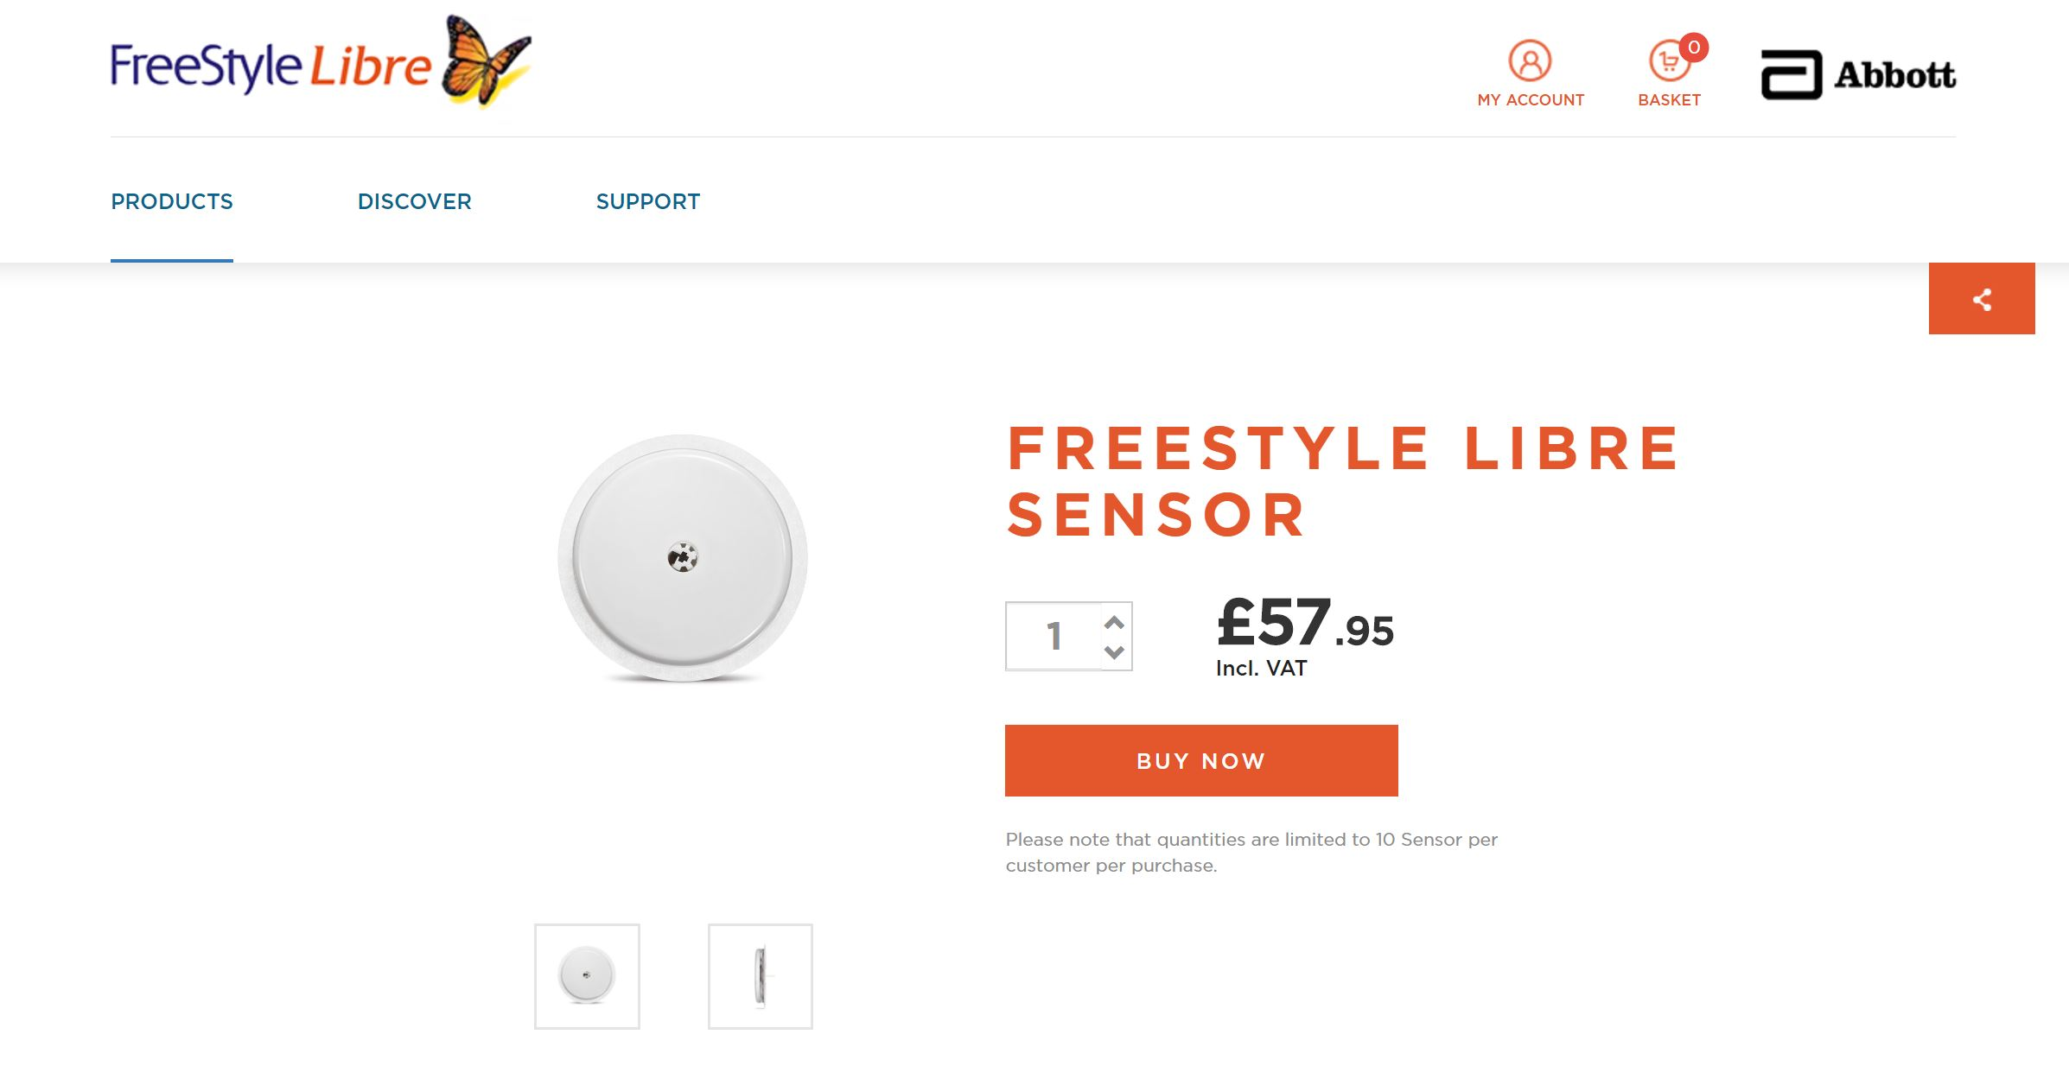
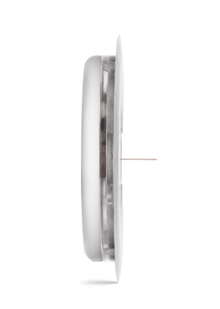
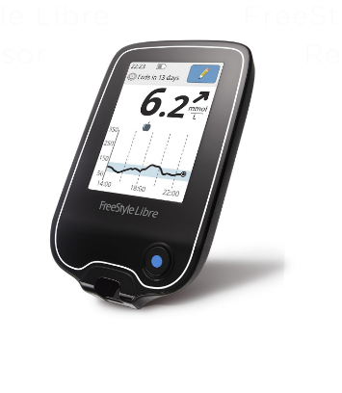
Type 1 diabetes: flash monitoring
Abbott Freestyle Libre
Notes:
6

Slide 7
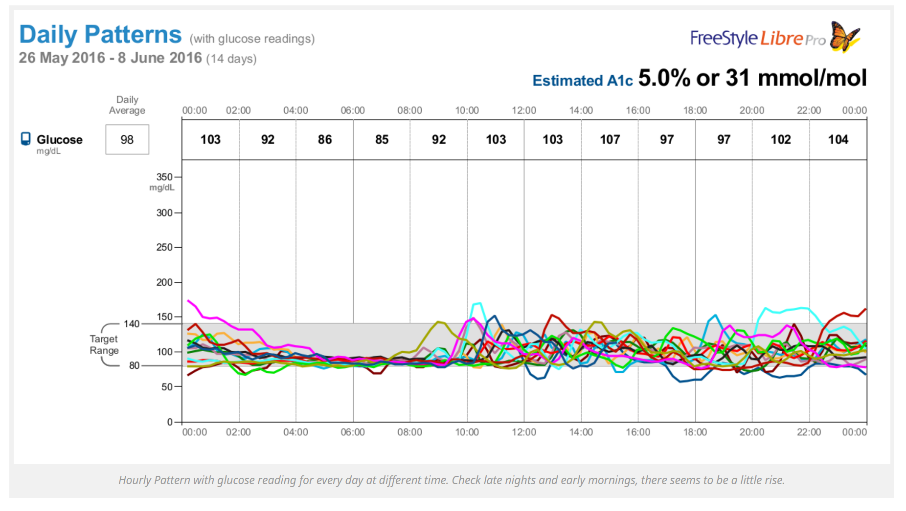

Slide 8
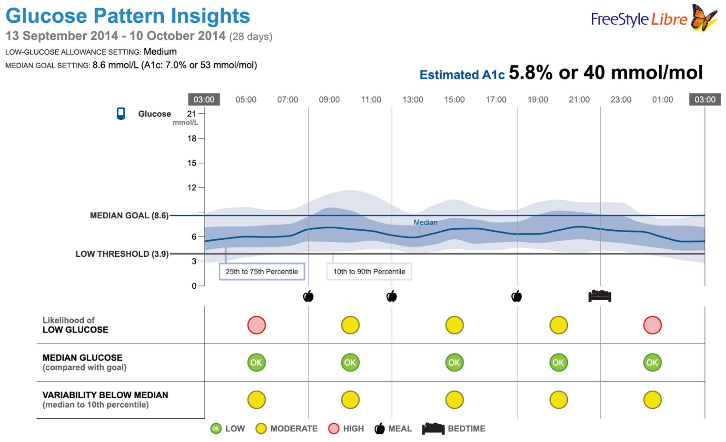
improved understanding of glycaemia leads to better decision making by patients and doctors
Notes:
8

Slide 9
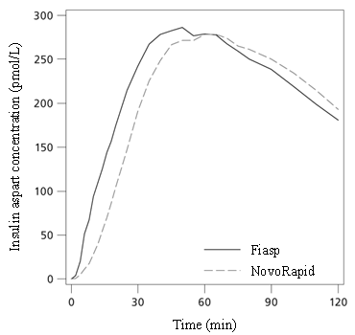
Type 1 diabetes: new insulins
faster acting short-acting insulins
reduce interval required pre-meal for dosing
quicker time to peak reduces post-prandial glucose
faster asparte (FIAsp)
x2 AUC in first 30 mins
faster onset of action
Notes:
9

Slide 10
Type 1 diabetes: new insulins
longer acting long-acting insulins
lower intra-individual variability of day-to-day action
less overnight hypoglycaemia
dose timing flexibility
? less DKA in intermittent insulin users
insulin glargine U300 (Tuojeo)
insulin degludec (Tresiba)
Notes:
10

Slide 11
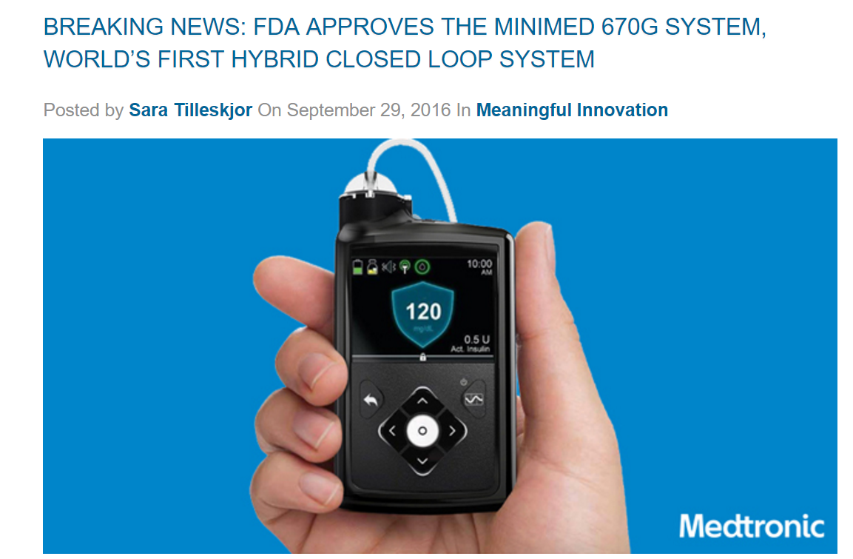
Type 1 diabetes: pump technologies
Medtronic 670G – FDA approved
Notes:
11

Slide 12
glucose sensing via CGMS
Hybrid Closed Loop
algorithm
manual entry:
CHO intake
insulin dose adjustment

Slide 13
glucose sensing via CGMS
Hybrid Closed Loop
algorithm
manual entry:
CHO intake
model / fuzzy logic based
no machine learning / AI element
insulin dose adjustment

Slide 14
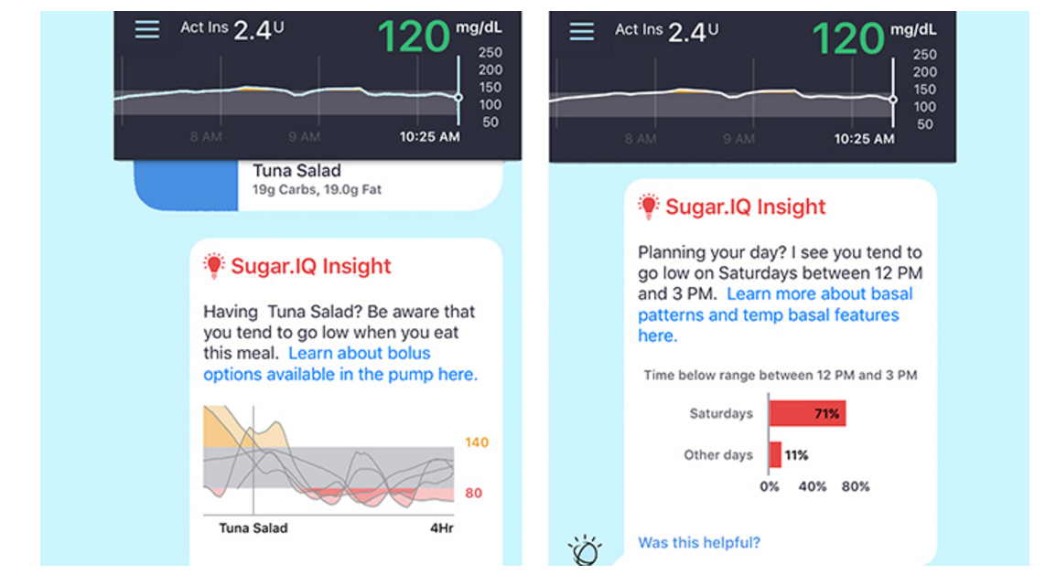
Type 1 diabetes: machine learning / AI
Medtronic / IBM Watson – sugar.IQ
pattern recognition using multiple data sources:
CBG / CGMS, accelerometer data, CHO / nutritional data, location, weather etc

Slide 15
Type 2 Diabetes
Notes:
15

Slide 16
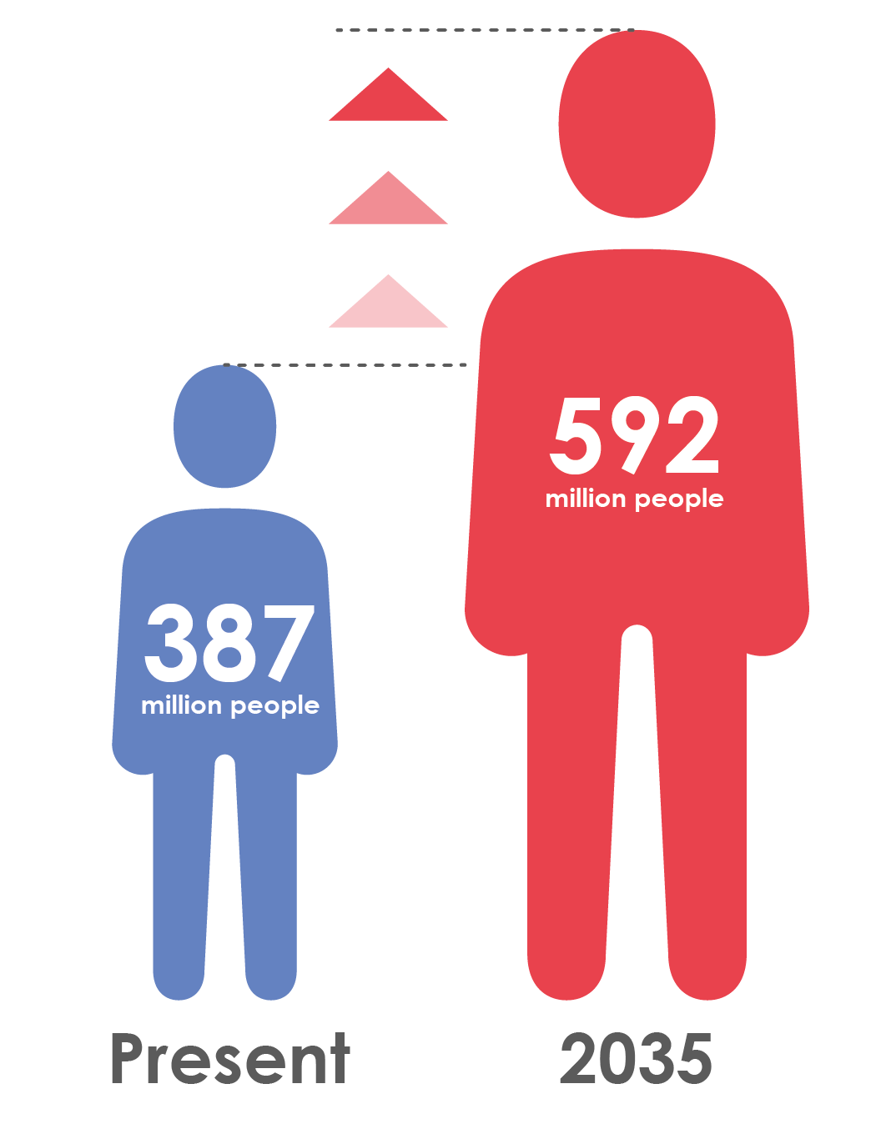
Type 2 diabetes is increasingly prevalent
Globally, 387 million people are living with diabetes¹
At least 68% of people >65 years with diabetes die of heart disease²
Mortality risk associated with diabetes (n=820,900)³
This will rise to 592 million by 2035¹
1. IDF Diabetes Atlas 6th Edition 2014 http://www.idf.org/diabetesatlas; 2. Centers for Disease Control and Prevention , National Diabetes Fact Sheet, 2011 Available at http://www.cdc.gov/diabetes/pubs/pdf/ndfs_2011.pdf; 3. Seshasai SRK et al. N Engl J Med 2011;364:829-41 Supplementary Appendix
Notes:
16

Slide 17
Diabetes is associated with significant loss of life years
Men
Women
7
6
5
4
3
2
1
0
Non-vascular deaths
Vascular deaths
7
6
5
4
3
2
1
0
Years of life lost
0
40
50
60
70
80
90
0
40
50
60
70
80
90
Age (years)
Age (years)
On average, a 50-year-old individual with diabetes and no history of vascular disease will die 6 years earlier compared to someone without diabetes
.
Seshasai SRK et al. N Engl J Med 2011;364:829-41
Notes:
17

Slide 18
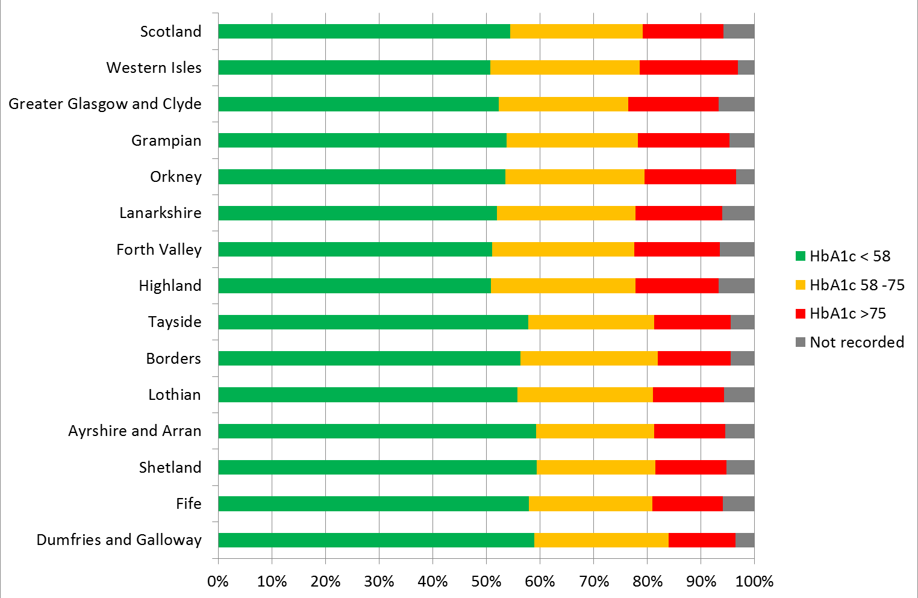
How well do we manage glycaemia in T2DM?
Scottish Diabetes Survey 2015
Number of Patients with Type 2 with HbA1c Controlled

Slide 19
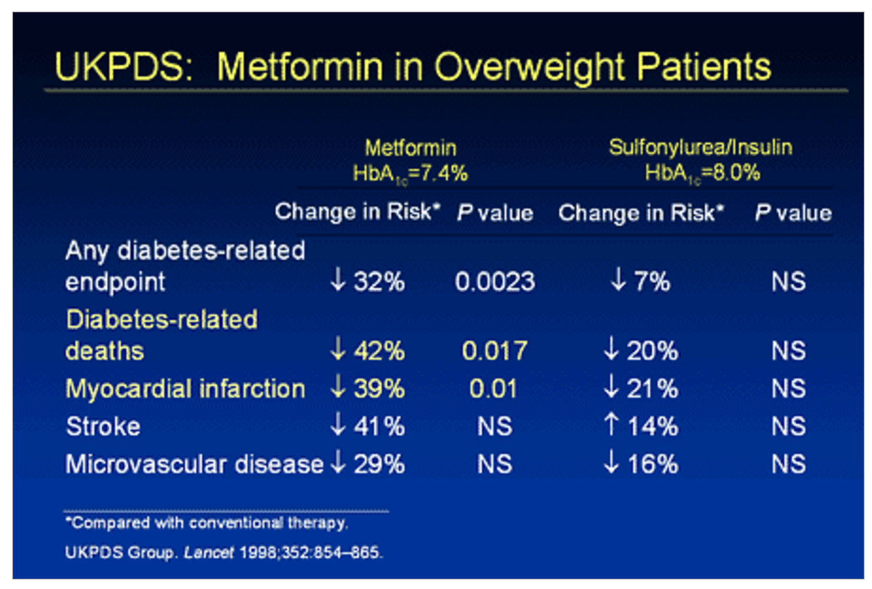
Type 2 diabetes: guidelines
many in existence
all basically similar ie
metformin + others in various orders
what is the mortality evidence for other agents?
Notes:
19

Slide 20
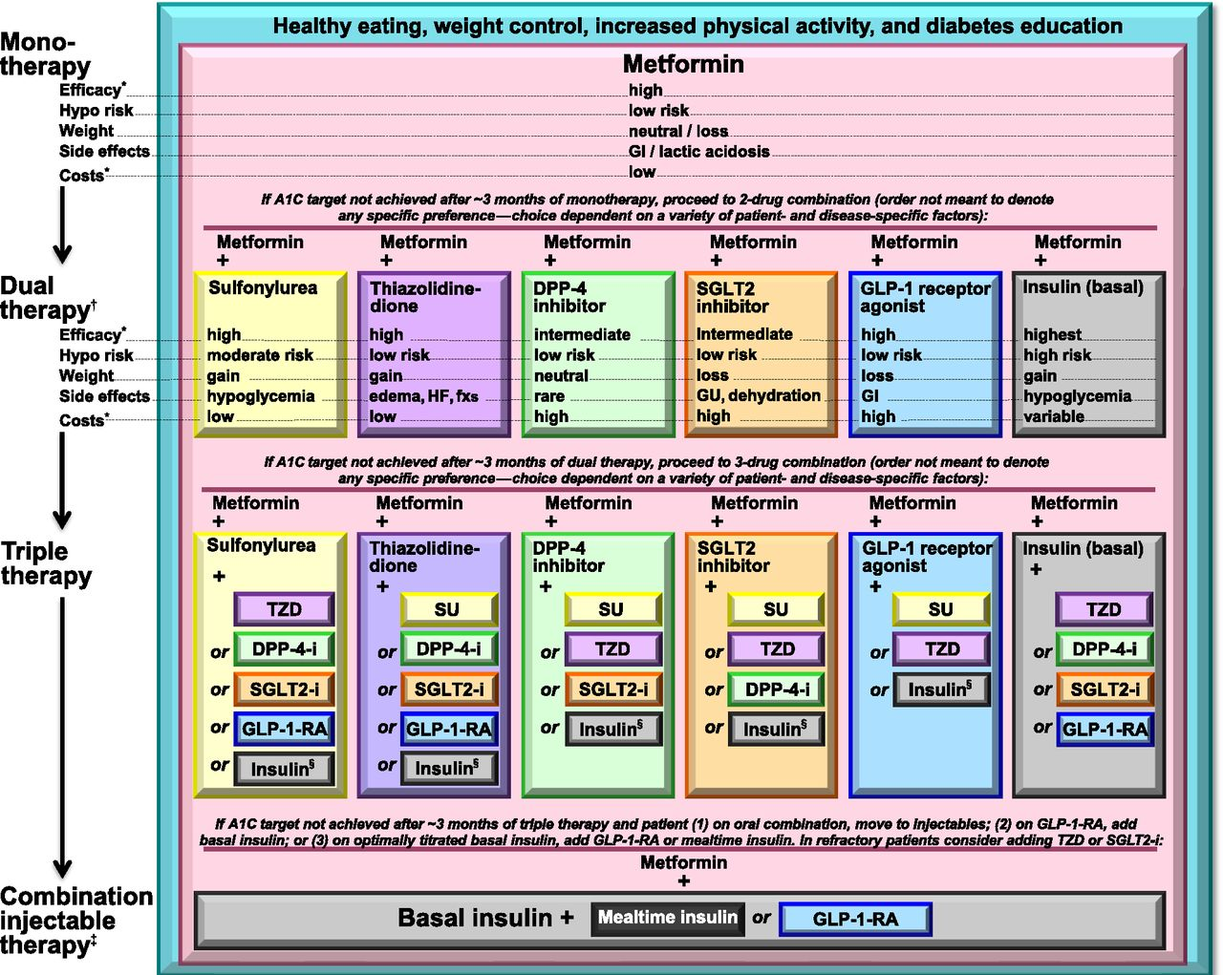

Antihyperglycemic therapy in type 2 diabetes: general recommendations (15).
American Diabetes Association Dia Care 2015;38:S41-S48
©2015 by American Diabetes Association
Notes:
Antihyperglycemic therapy in type 2 diabetes: general recommendations (15). The order in the chart was determined by historical availability and the route of administration, with injectables to the right; it is not meant to denote any specific preference. Potential sequences of antihyperglycemic therapy for patients with type 2 diabetes are displayed, with the usual transition moving vertically from top to bottom (although horizontal movement within therapy stages is also possible, depending on the circumstances). DPP-4-i, DPP-4 inhibitor; fxs, fractures; GI, gastrointestinal; GLP-1-RA, GLP-1 receptor agonist; GU, genitourinary; HF, heart failure; Hypo, hypoglycemia; SGLT2-i, SGLT2 inhibitor; SU, sulfonylurea; TZD, thiazolidinedione. *See ref. 15 for description of efficacy categorization. †Consider starting at this stage when A1C is ≥9%. ‡Consider starting at this stage when blood glucose is ≥300–350 mg/dL (16.7–19.4 mmol/L) and/or A1C is ≥10–12%, especially if symptomatic or catabolic features are present, in which case basal insulin + mealtime insulin is the preferred initial regimen. §Usually a basal insulin (NPH, glargine, detemir, degludec). Adapted with permission from Inzucchi et al. (15).

Slide 21
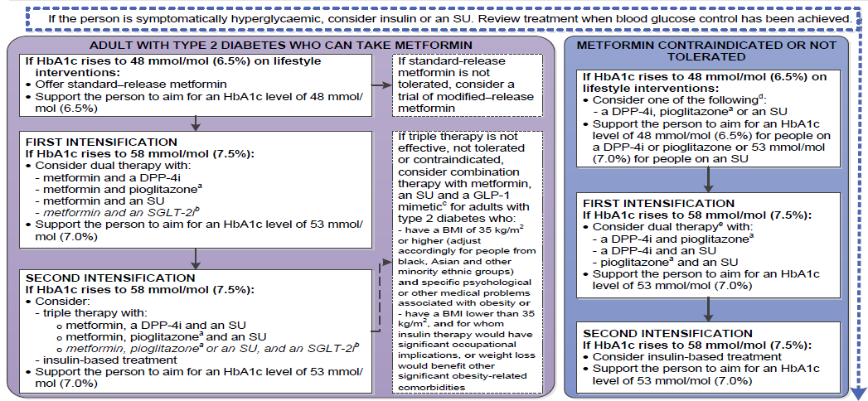
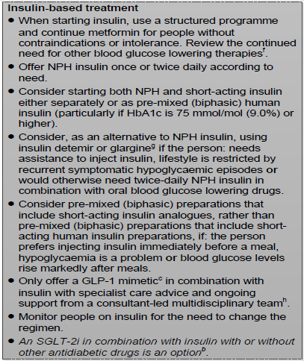
NICE NG28 – Algorithm for blood glucose lowering therapy in adults with type 2 diabetes
NICE updated its guidance for type 2 diabetes in Dec 2015 (NG28)
This sets an initial HbA1c target of 6.5%, with a target of 7.0% at further intensification steps with 3/6 month patient reviews
Adapted from NICE Guideline NG28 http://www.nice.org.uk/guidance/ng28/resources/algorithm-for-blood-glucose-lowering-therapy-in-adults-with-type-2-diabetes-2185604173 accessed 26th Jan 2016

Slide 22
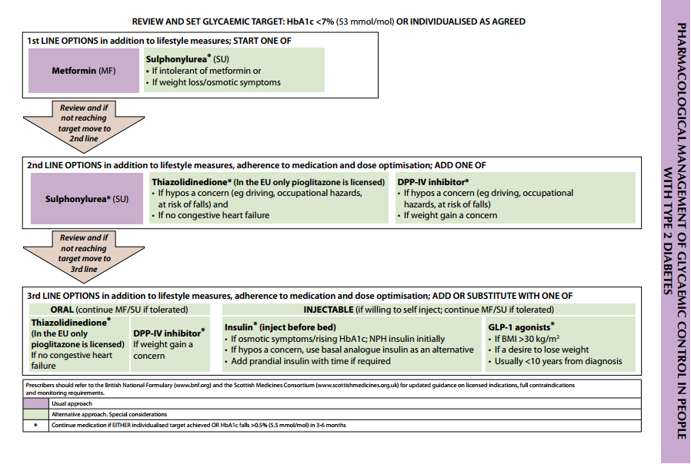
SIGN recommendations for pharmacological management of glycaemic control in people with T2D
Reference SIGN clinical guideline 116. Management of diabetes. March 2010 Available at: http://www.sign.ac.uk/guidelines/fulltext/116/ (accessed September 2014).
Notes:
Note to Dr Jones: Taken from SIGN guideline – we can leave as is if you think this should be recognisable or re-draw so it’s clearer to read.
22

Slide 23
NHS GGC Guidelines
http://ggcprescribing.org.uk/clinical-guidelines/

Slide 24
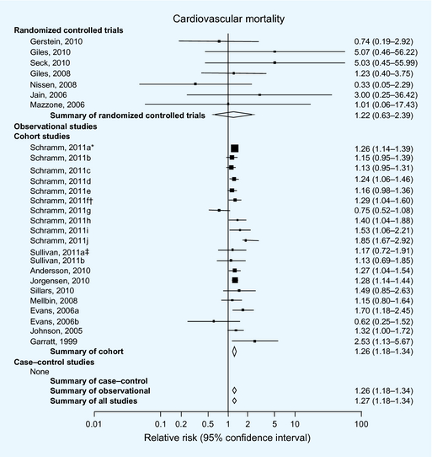
Sulphonylureas and risk of cardiovascular disease: systematic review and meta‐analysis
Diabetic Medicine Volume 30, Issue 10, pages 1160-1171, 16 SEP 2013 DOI: 10.1111/dme.12232 http://onlinelibrary.wiley.com/doi/10.1111/dme.12232/full#dme12232-fig-0002
Notes:
24
Meta‐analysis results of studies comparing sulphonylureas to non‐sulphonylurea on cardiovascular mortality. *Schramm 2011a–e were conducted in patients without prior myocardial infarction, evaluating glimepiride, gliclazide, glyburide, glipizide and tolbutamide vs. metformin,respectively. †Schramm 2011f–j were conducted in patients with prior myocardial infarction, evaluating glimepiride, gliclazide, glyburide, glipizide and tolbutamide vs. metformin,respectively. ‡Sullivan 2011a compared sulphonylurea with metformin. §Sullivan 2011b compared sulphonylurea with diet. ¶Evans 2006a compared sulphonylurea with metformin. **Evans 2006b compared combination sulphonylurea and metformin with metformin alone.
© This slide is made available for non-commercial use only. Please note that permission may be required for re-use of images in which the copyright is owned by a third party.

Slide 25
Glucose-lowering treatments and associated CV risk
Risk of cardiovascular mortality and non-fatal myocardial infarction
(6171 events)
Metformin
Sulphonylureas
Tolbutamide
Gliclazide
Glipizide
Glimepiride
Gilbenclamide
Insulin
0.8
1
1.2
1.4
1.6
1.8
Hazard Ratio (metformin reference = 1)
CV: cardiovascular
Adapted from Jørgensen CH, et al. Cardiovasc Diabetol 2010;9:54.
Notes:
25

Slide 26
Inpatient with preadmission SU/metformin
CAR Sainsbury, SG Cunningham, GC Jones DIABETIC MEDICINE 2016 33, 193-193

Slide 27
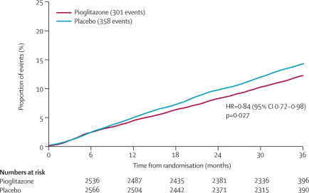
Secondary prevention of macrovascular events in patients with type 2 diabetes in the PROactive Study (PROspective pioglitAzone Clinical Trial In macroVascular Events): a randomised controlled trial
Figure 3. Kaplan-Meier curve of time to main secondary endpoint**Death from any cause, non-fatal myocardial infarction (excluding silent myocardial infarction), or stroke.
John A Dormandy et al
Lancet, Volume 366, Issue 9493, 2005, 1279–1289
http://dx.doi.org/10.1016/S0140-6736(05)67528-9

Slide 28
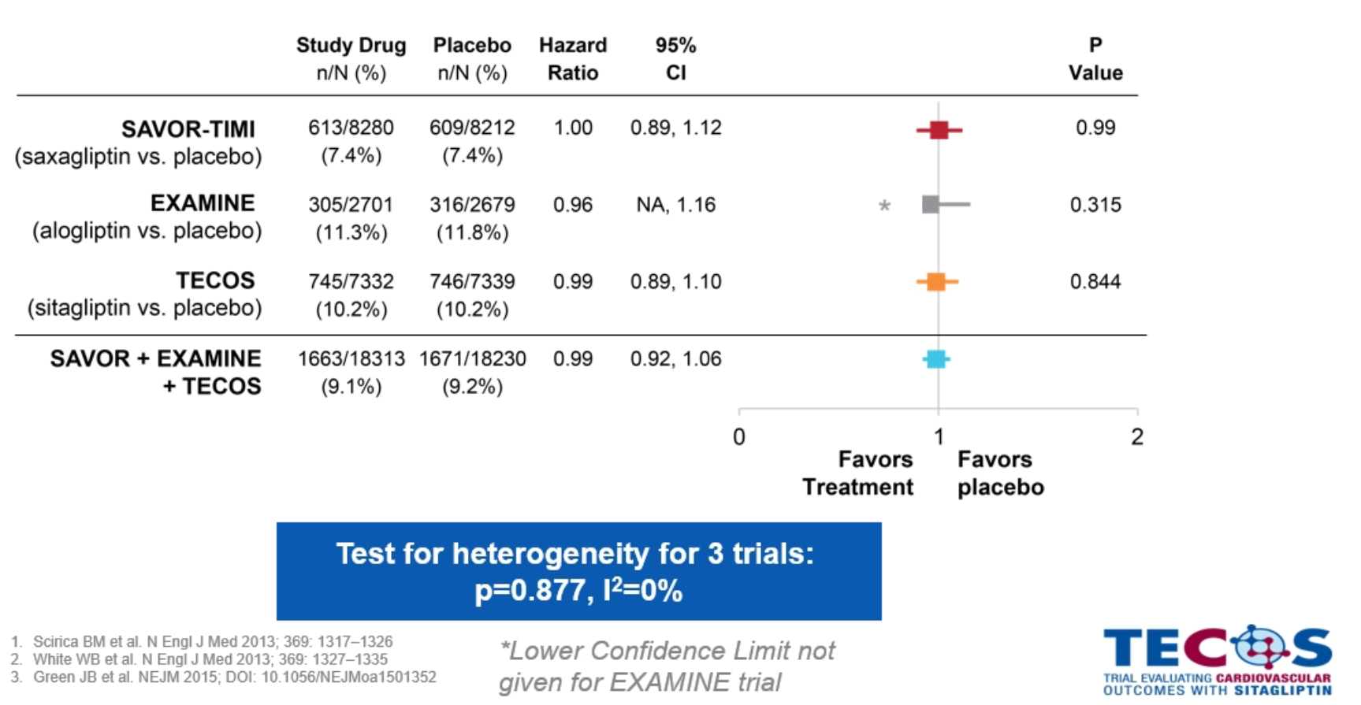
Cardiovascular safety studies (TECOS, EXAMINE, SAVOR-TIMI)

Slide 29
LEADER trial: Primary Outcome
First occurrence of CV death, nonfatal myocardial infarction, or nonfatal stroke in the time-to-event analysis in patients with type 2 diabetes and high CV risk.
Hazard ratio, 0.87 (95% CI, 0.78–0.97)
P<0.001 for noninferiority
P=0.01 for superiority
Patients with an event (%)
Placebo
Liraglutide
Months since randomisation
Liraglutide Effect and Action in Diabetes: Evaluation of cardiovascular outcome Results (LEADER) trial
Adapted from: Marso SP et al., NEJM 2016

Slide 30
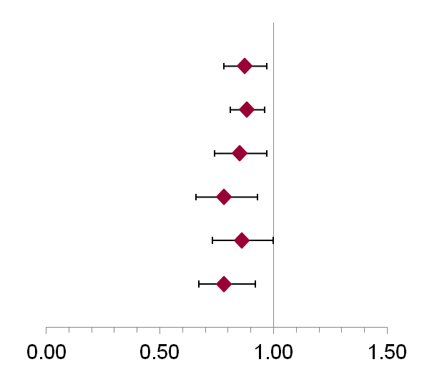
Liraglutide and Cardiovascular Outcomes in Type 2 Diabetes LEADER Trial Investigators N Engl J Med, 2016
LEADER
(N=9340)
 |  | Hazard ratio (95% CI) | P value
Primary composite endpoint* |  | 0.87 (0.78-0.97) | 0.01
Expanded composite endpoint† |  | 0.88 (0.81-0.96) | 0.005
Death from any cause |  | 0.85 (0.74-0.97) | 0.02
CV death |  | 0.78 (0.66-0.93) | 0.007
Fatal or nonfatal MI |  | 0.86 (0.73-1.00) | 0.046
Nephropathy |  | 0.78 (0.67-0.92) | 0.003
Favors liraglutide
*CV death, nonfatal MI (including silent MI), or nonfatal stroke; †CV death, nonfatal MI (including silent MI), nonfatal stroke, coronary revascularization, and hospitalization for unstable angina or HF.
CI, confidence interval; CV, cardiovascular; MI, myocardial infarction.
30

Slide 31
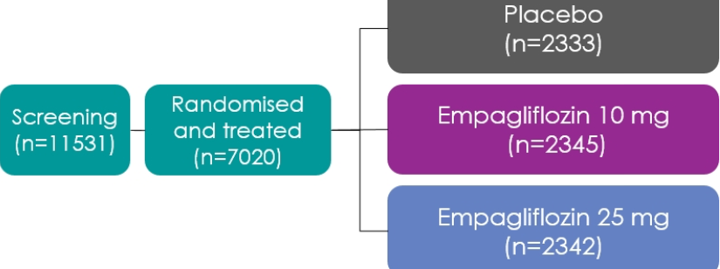
Empagliflozin, Cardiovascular Outcomes, and Mortality in Type 2 Diabetes Bernard Zinman et al, NEJM, 2015

Slide 32
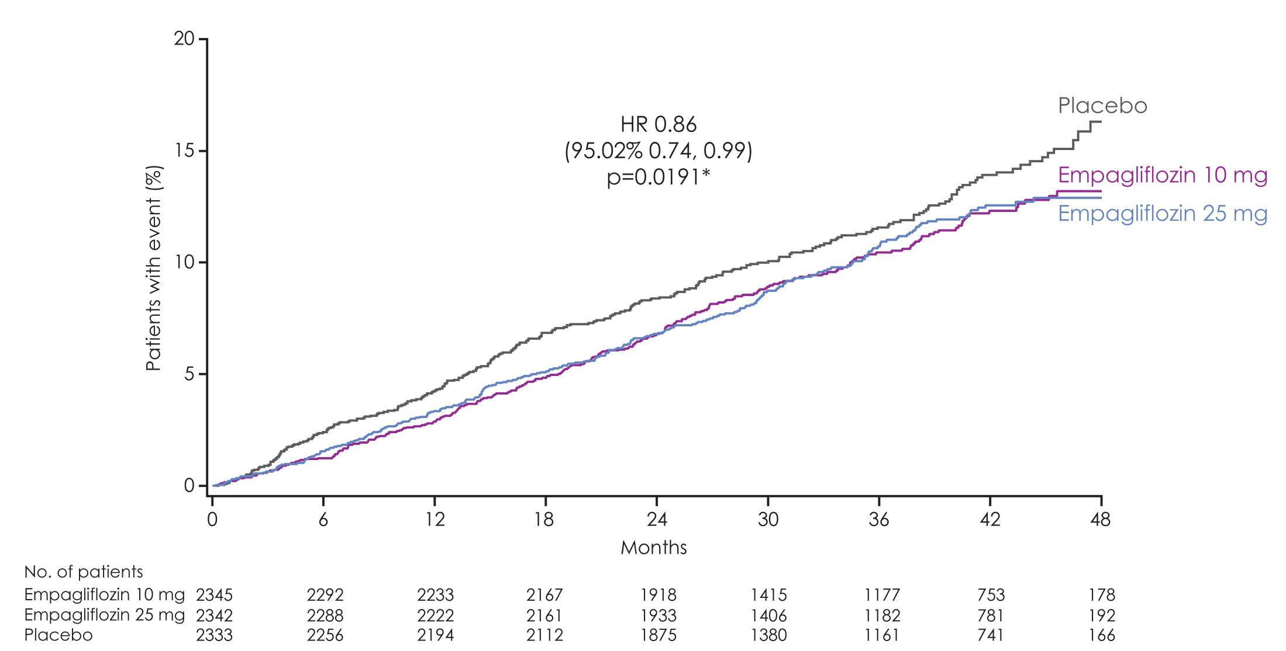
3-point MACE
Empagliflozin 10 mg
HR 0.85
(95% CI 0.72, 1.01)
p=0.07
Empagliflozin 25 mg
HR 0.86
(95% CI 0.73, 1.02)
p=0.09
Cumulative incidence function. MACE, Major Adverse Cardiovascular Event; HR, hazard ratio
Zinman B et al. N Engl J Med 2015 DOI: 10.1056/NEJMoa1504720 Supplementary Appendix
Notes:
32

Slide 33
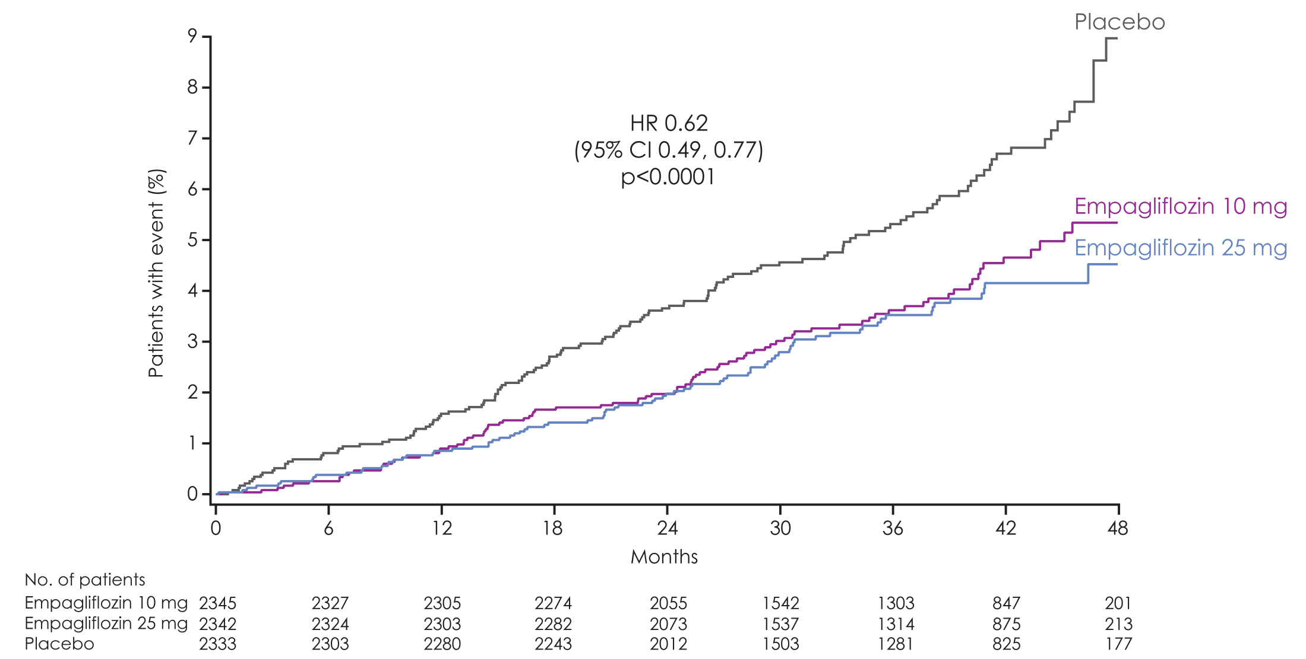
CV death
Empagliflozin 10 mg
HR 0.65
(95% CI 0.50, 0.85)
p=0.002
RRR: 35%
ARR: 2.1%
Empagliflozin 25 mg
HR 0.59
(95% CI 0.45, 0.77)
p=<0.001
RRR: 41%
ARR: 2.4%
Cumulative incidence function. HR, hazard ratio; RRR: Relative risk reduction; ARR; Absolute risk reduction; CER: Control Event Rate; EER: Experimental Event rate. ARR = CER – EER. Zinman B et al. N Engl J Med 2015 DOI: 10.1056/NEJMoa1504720 Supplementary Appendix
Notes:
33

Slide 34
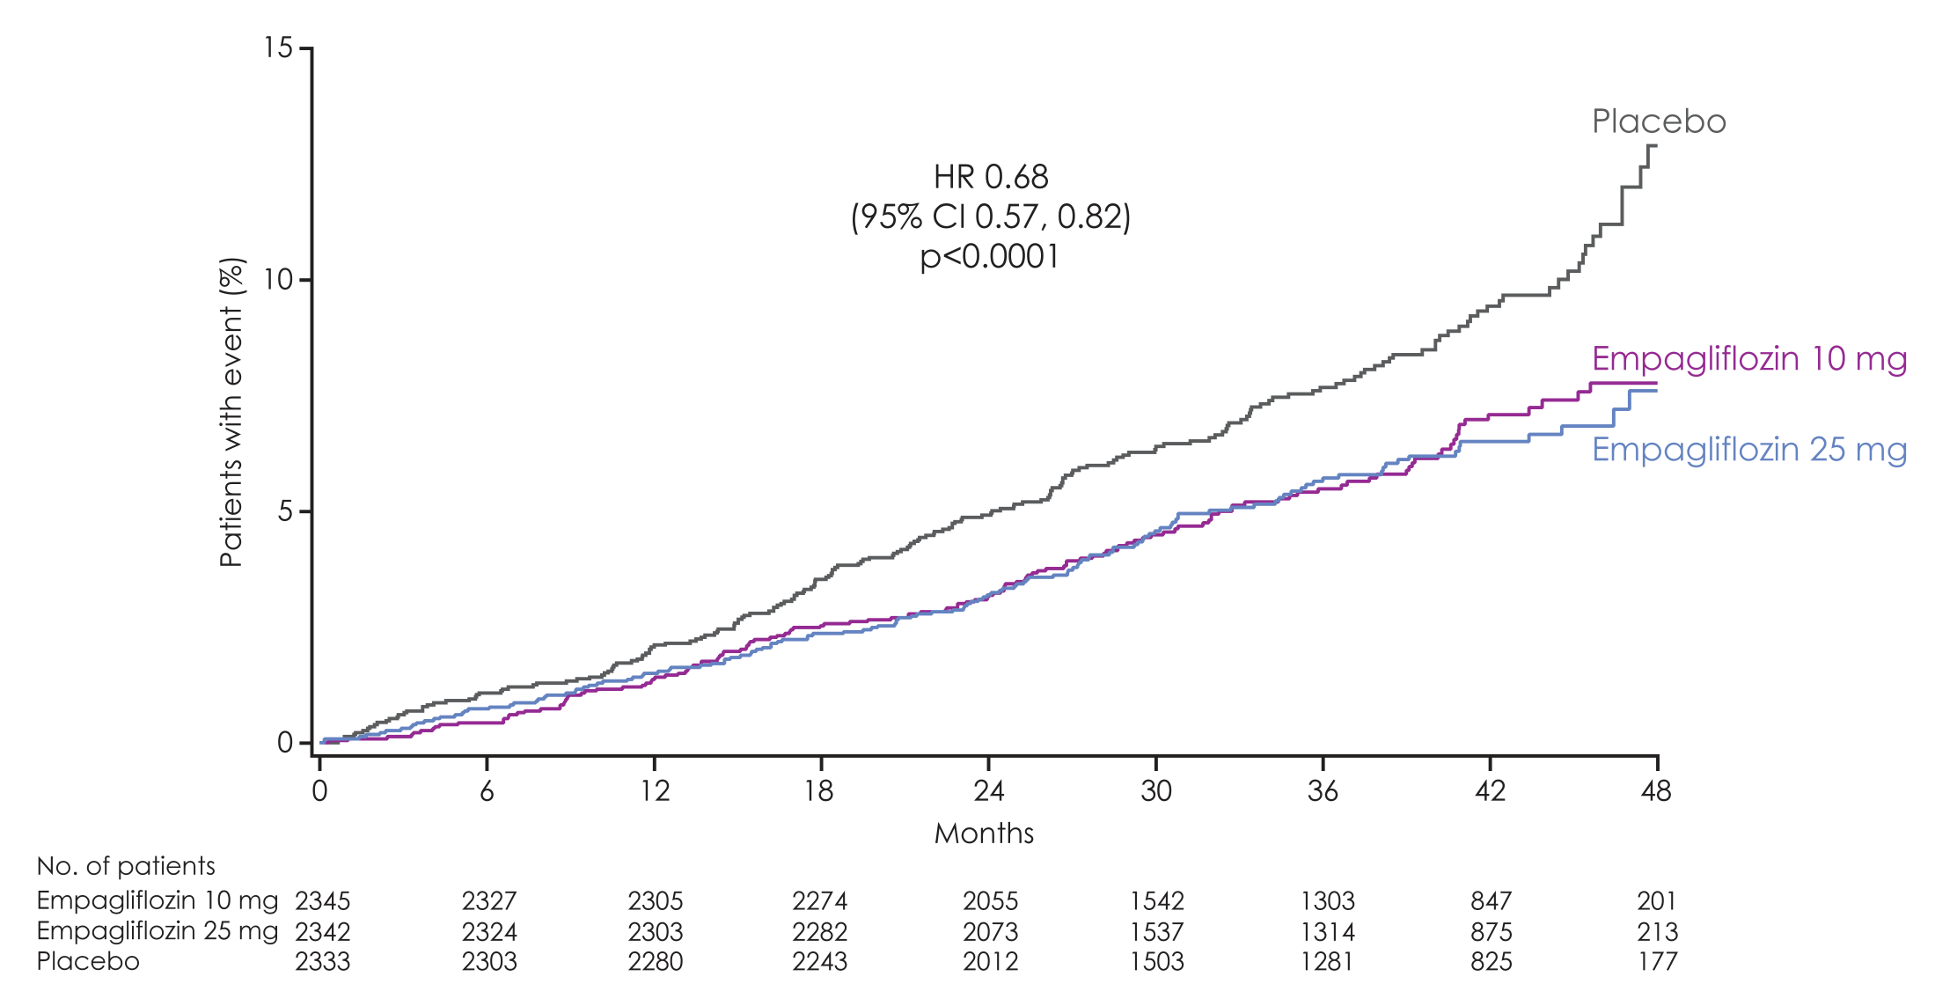
All-cause mortality
Empagliflozin 10 mg
HR 0.70
(95% CI 0.56, 0.87)
p=0.001
RRR: 30%
ARR: 2.5%
Empagliflozin 25 mg
HR 0.67
(95% CI 0.54, 0.83)
p=<0.001
RRR: 33%
ARR: 2.7%
HR 0.68
(95% CI 0.57, 0.82)
p<0.0001
Kaplan-Meier estimate. HR, hazard ratio; RRR: Relative risk reduction; ARR; Absolute risk reduction; CER: Control Event Rate;
EER: Experimental Event rate. ARR = CER – EER.
Zinman B et al. N Engl J Med 2015 DOI: 10.1056/NEJMoa1504720 Supplementary Appendix
Notes:
34

Slide 35
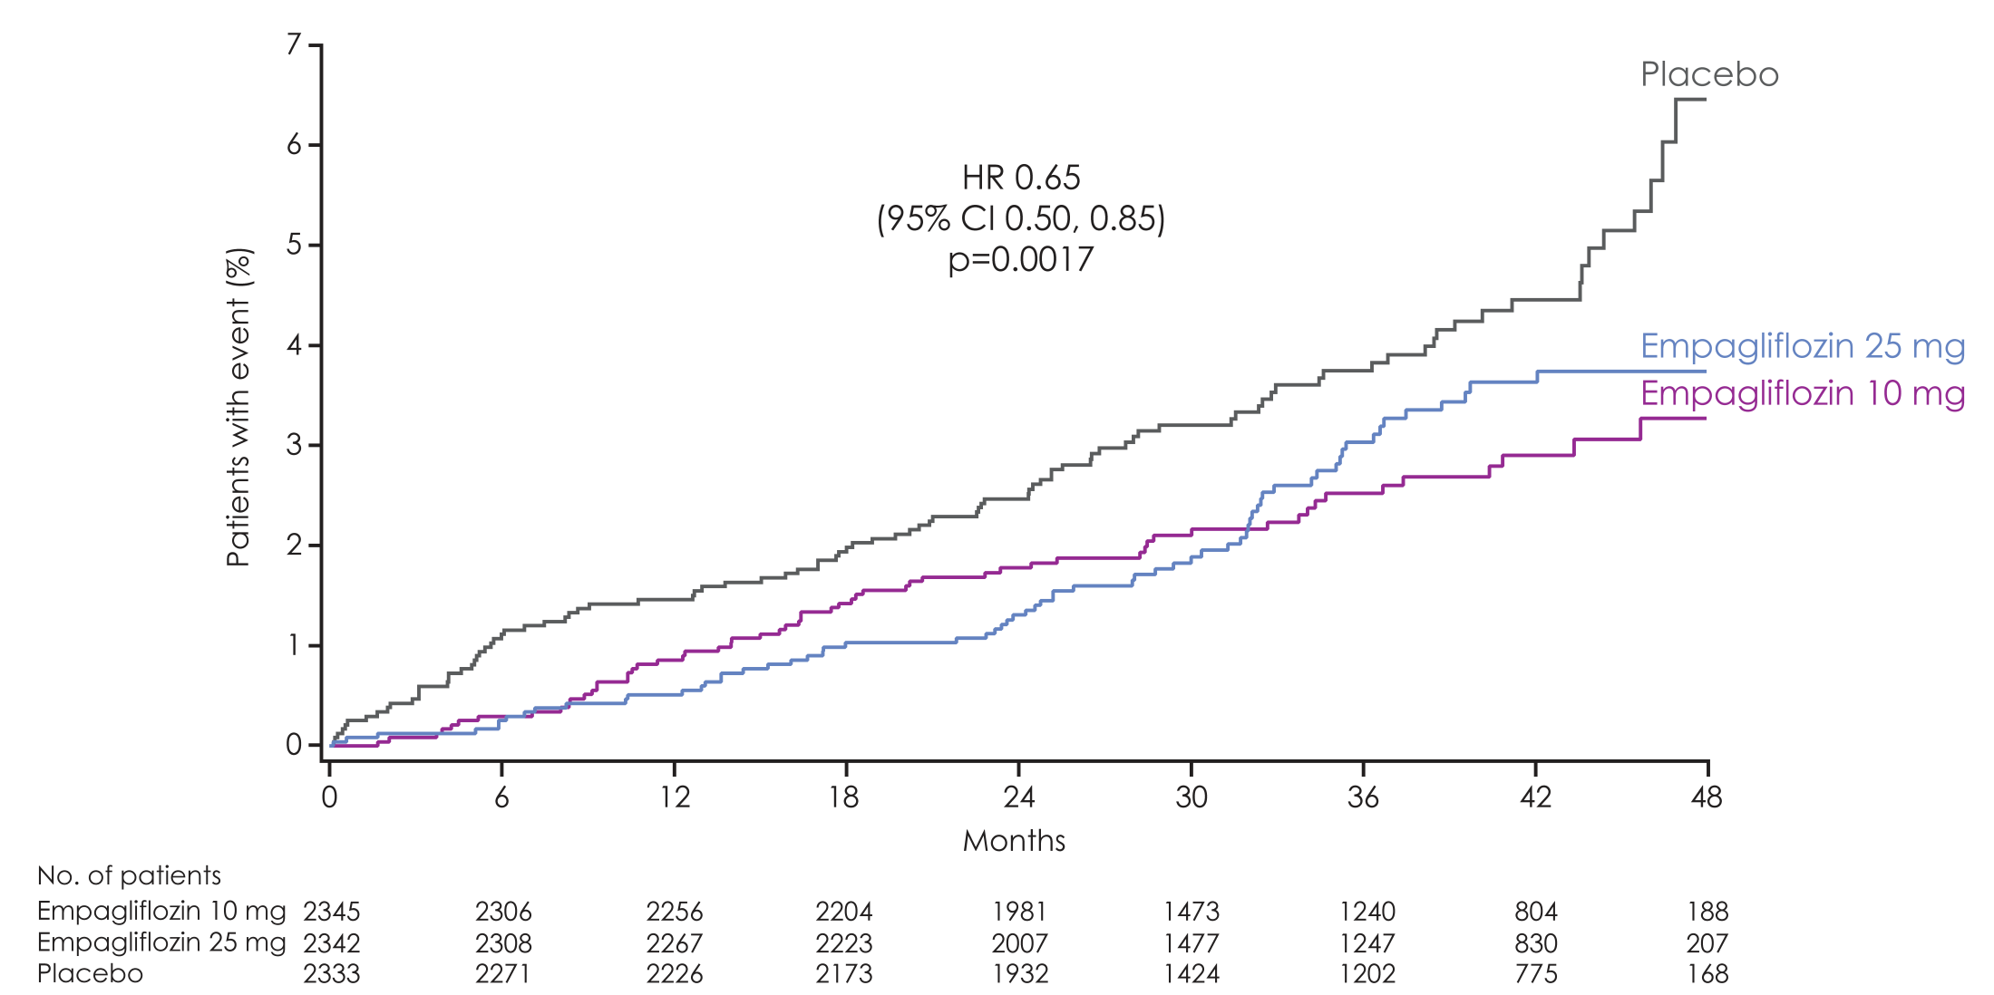
Hospitalisation for heart failure
Empagliflozin 10 mg
HR 0.62
(95% CI 0.45, 0.86)
p=0.004
RRR: 38%
ARR: 1.5%
Empagliflozin 25 mg
HR 0.68
(95% CI 0.50, 0.93)
p=0.02
RRR: 32%
ARR: 1.3%
Cumulative incidence function. HR, hazard ratio; RRR: Relative risk reduction; ARR; Absolute risk reduction; CER: Control Event Rate; EER: Experimental Event rate. ARR = CER – EER
Zinman B et al. N Engl J Med 2015 DOI: 10.1056/NEJMoa1504720 Supplementary Appendix
Notes:
35

Slide 36
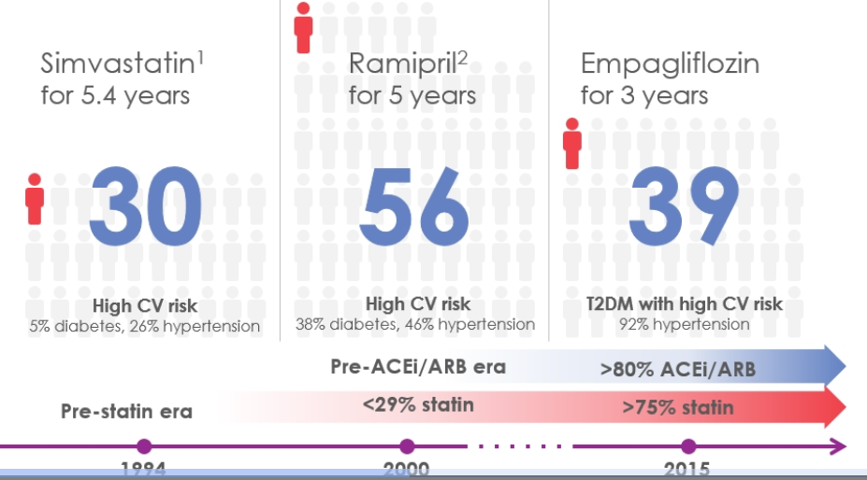
Numbers needed to treat comparison

Slide 37
Type 2 diabetes
optimum drug sequence (in high CV risk) may be:
metformin -> empagliflozin -> liraglutide
new evidence coming this year for other SGLT2s ? extending benefit into non-high CV risk patients
Notes:
37

Slide 38
Summary
T1DM – advances are likely to come from technology / bioengineering and data science.
T2DM – advances likely to come from optimum drug combinations based on large number of ongoing outcome trials.
Notes:
38

Slide 39
Notes:
39

